Slide 1
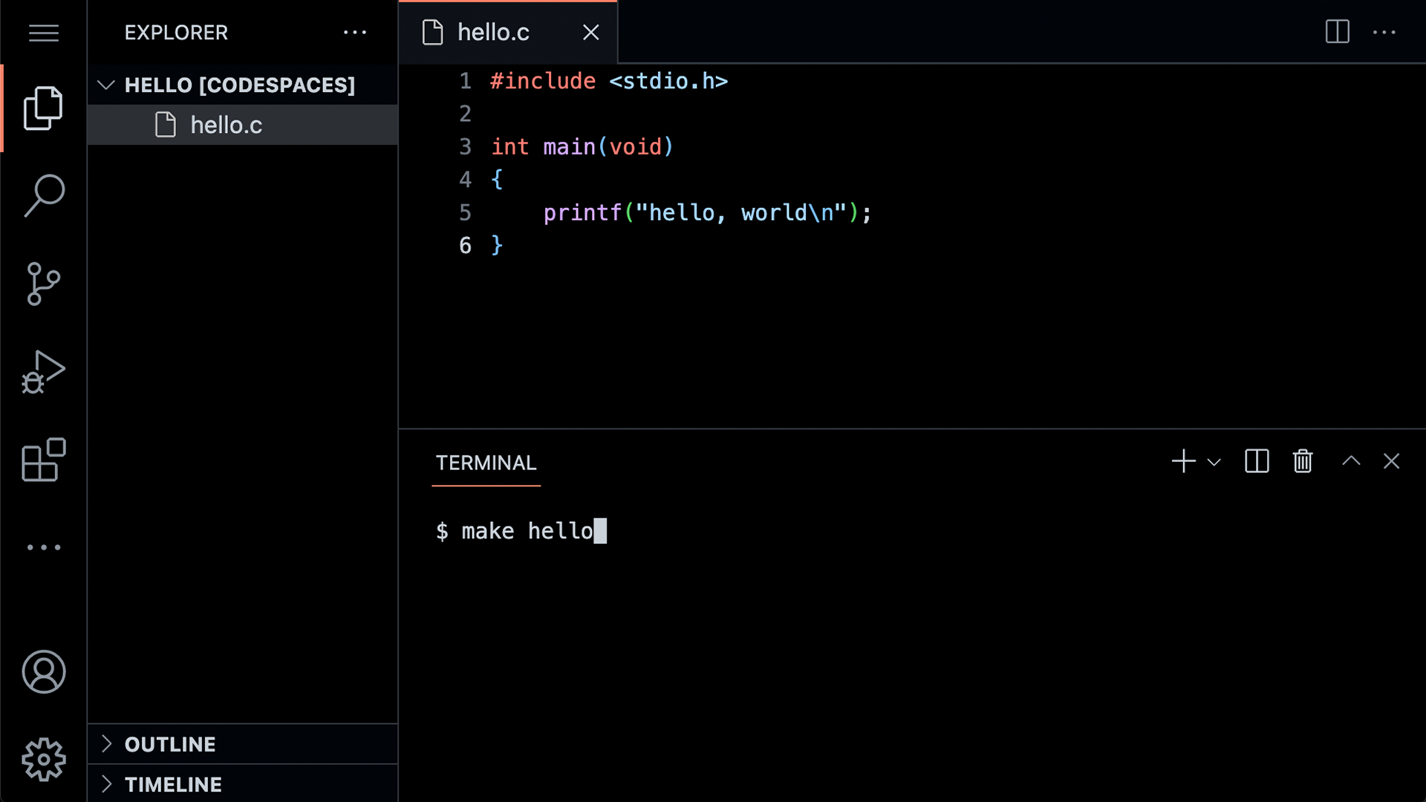

Slide 6
#include <stdio.h>
int main(void) {
printf("hello, world\n");
}

Slide 7
code hello.c
make hello
./hello

Slide 8
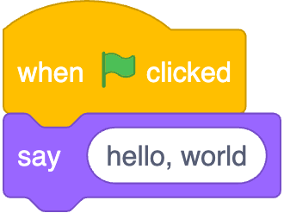

Slide 9
function
arguments/parameters →
→ side effects

Slide 10
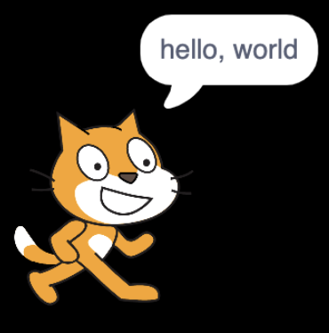


→
→

Slide 11

printf("hello, world\n");

Slide 12
printf("hello, world\n");

Slide 13
printf("hello, world\n");

Slide 14
printf("hello, world\n");

Slide 15
printf("hello, world\n");

Slide 16
printf("hello, world\n");

Slide 17
printf("hello, world\n");

Slide 18
header files

Slide 19
libraries

Slide 20
Manual Pages
manual.cs50.io

Slide 21
stdio.h

Slide 22
manual.cs50.io/#stdio.h

Slide 23
manual.cs50.io/3/printf

Slide 24
cs50.h

Slide 25
manual.cs50.io/#cs50.h

Slide 26
get_char
get_double
get_float
get_int
get_long
get_string
...

Slide 27
get_char
get_double
get_float
get_int
get_long
get_string
...

Slide 28
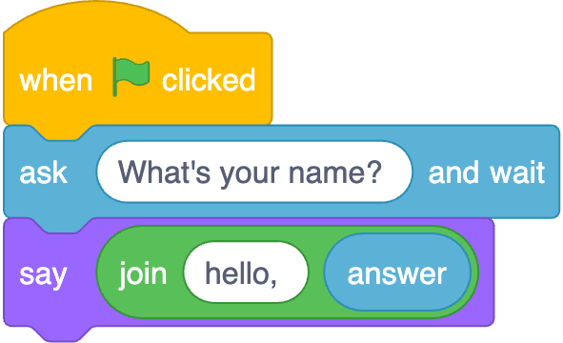

Slide 29
function
arguments →
→ return value

Slide 30
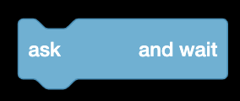


→
→

Slide 31
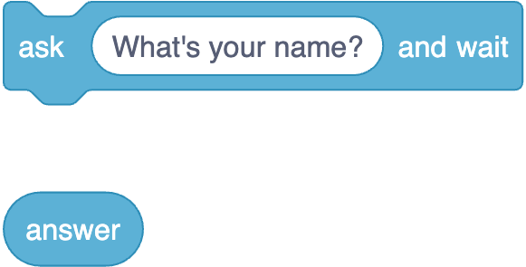

Slide 32
string answer = get_string( );
printf("hello, %s", answer);

Slide 33
string answer = get_string("What's your name? ");
printf("hello, %s", answer);

Slide 34
string answer = get_string("What's your name? ");
printf("hello, %s", answer);

Slide 35
string answer = get_string("What's your name? ");
printf("hello, %s", answer);

Slide 36
string answer = get_string("What's your name? ");
printf("hello, %s", answer);

Slide 37
string answer = get_string("What's your name? ");
printf("hello, %s", answer);

Slide 38
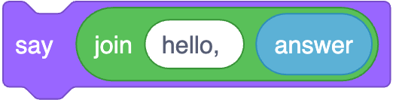
printf("hello, %s", answer);

Slide 39
printf("hello, %s\n", answer);

Slide 40
printf("hello, %s\n", answer);

Slide 41
printf("hello, %s\n", answer);

Slide 42
printf("hello, %s\n", answer);

Slide 43
printf("hello, %s\n", answer);

Slide 44
types

Slide 45
bool
char
double
float
int
long
string
...

Slide 46
bool
char
double
float
int
long
string
...

Slide 47
bool
char
double
float
int
long
string
...

Slide 48
get_char
get_double
get_float
get_int
get_long
get_string
...

Slide 49
get_char
get_double
get_float
get_int
get_long
get_string
...

Slide 50
format codes

Slide 51
%c
%f
%i
%li
%s

Slide 52
%c
%f
%i
%li
%s

Slide 53
%c
%f
%i
%li
%s

Slide 54
conditionals

Slide 55
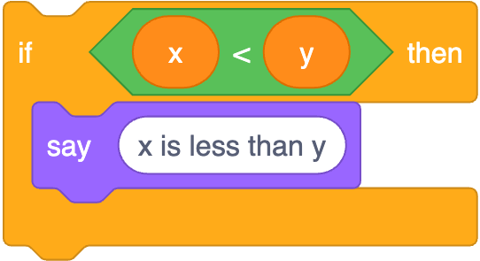
if (x < y) {
printf("x is less than y\n");
}

Slide 56
if (x < y) {
printf("x is less than y\n");
}

Slide 57
if (x < y) {
printf("x is less than y\n");
}

Slide 58
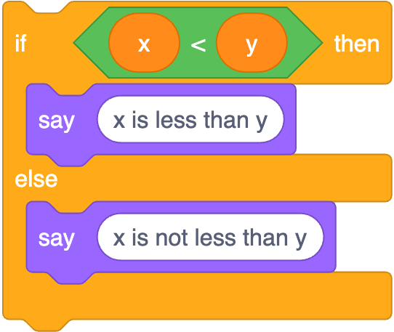
if (x < y) {
printf("x is less than y\n");
}
else
{ printf("x is not less than y\n");
}

Slide 59
if (x < y) {
printf("x is less than y\n");
}
else
{ printf("x is not less than y\n");
}

Slide 60
if (x < y) {
printf("x is less than y\n");
}
else
{ printf("x is not less than y\n");
}

Slide 61
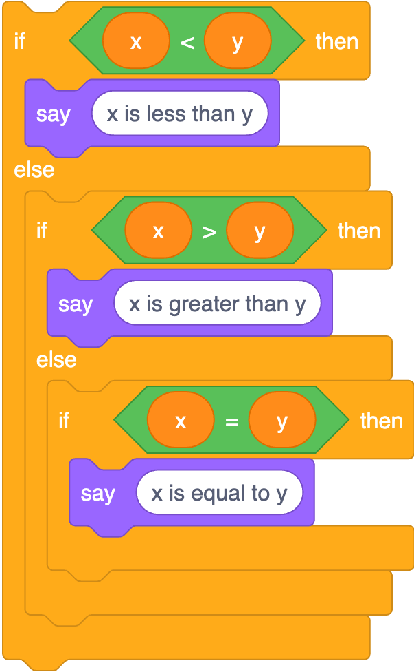
if (x < y) {
printf("x is less than y\n");
}
else if (x > y)
{ printf("x is greater than y\n");
}
else if (x == y)
{ printf("x is equal to y\n");
}

Slide 62
if (x < y) {
printf("x is less than y\n");
}
else if (x > y)
{ printf("x is greater than y\n");
}
else if (x == y)
{ printf("x is equal to y\n");
}

Slide 63
if (x < y) {
printf("x is less than y\n");
}
else if (x > y)
{ printf("x is greater than y\n");
}
else if (x == y)
{ printf("x is equal to y\n");
}

Slide 64
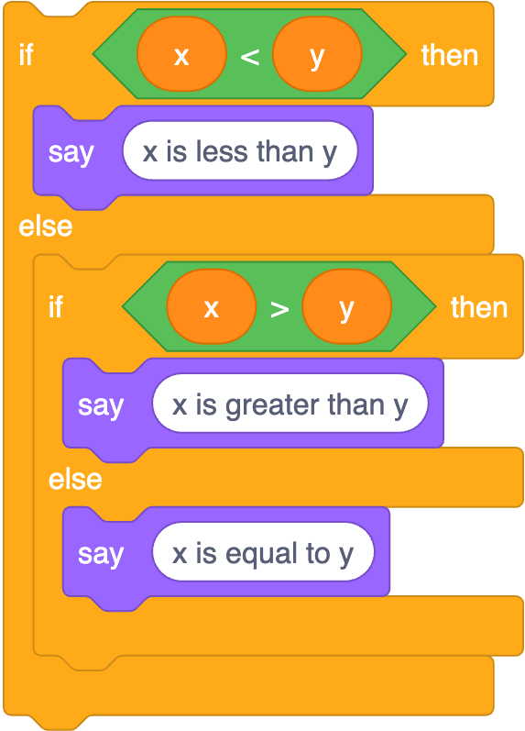
if (x < y) {
printf("x is less than y\n");
}
else if (x > y)
{ printf("x is greater than y\n");
}
else
{ printf("x is equal to y\n");
}

